Slide 1
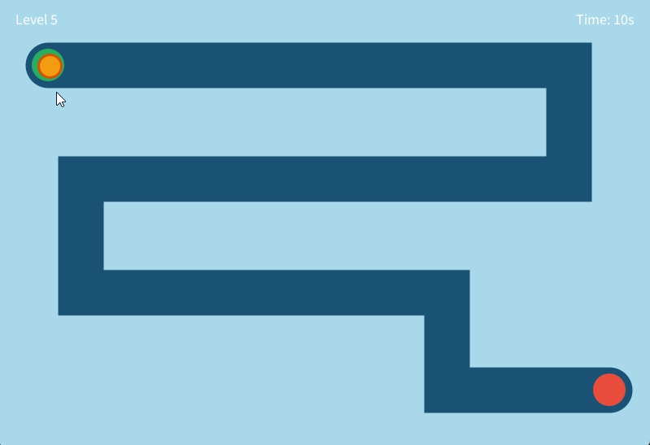
Canal Rush
A mouse-controlled navigation game .
Guide the orange ball through narrowing canals before time runs out. Hit the walls or run out of time and it's game over.
Inspired by the classic game “Ring Challenge”.
Team
2024/ICTS/028 - JADN THINESH
2024/ICTS/140 - GGKS GUNASEKARA
2024/ICTS/141 - DMRS DISSANAYAKA

Slide 2
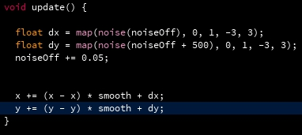
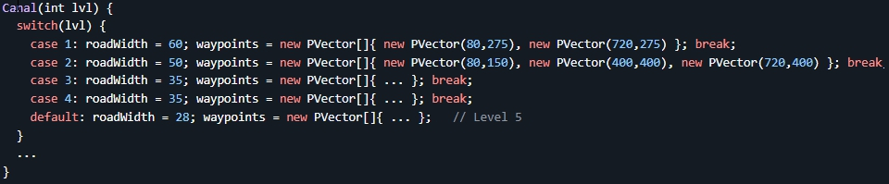
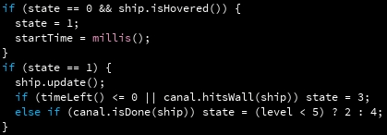

The Code
A switch on the level number selects the layout.
Each level Defines corner waypoints (the route the canal follows)
Sets roadWidth (narrower = harder)
new PVector(80, 275) creates a point at x=80, y=275. The new PVector[]{ ... } syntax creates an array of PVectors in one line.
Perlin noise adds natural drift to the ball as it chases the mouse, making controlling the ball harder.
A 5-state finite state machine drives the whole game loop clean and easy to extend.
lerp() samples points along each canal segment. hitsWall() checks ship distance against that sampled path.

Slide 3
What we learned
How OOP classes keep code organized and reuseable.
How state machines works.
How perlin noise create motion.
How lerp() and PVector calculate paths.
Source Used
Claude Code
Processing Reference
The Coding Train (YouTube)
What We’d improve with more time.
Custom canal generator with infinity levels.
Moving obstacles.
Good visuals rather than circles and rectangles.
Adding audio.
Thank you!

